Slide 1

Curriculum 2: Mechatronics and Robotics Engineering at LTU
James A. Mynderse

Slide 2

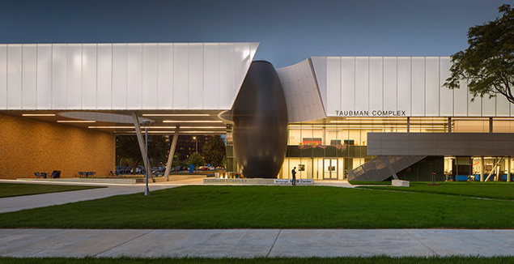
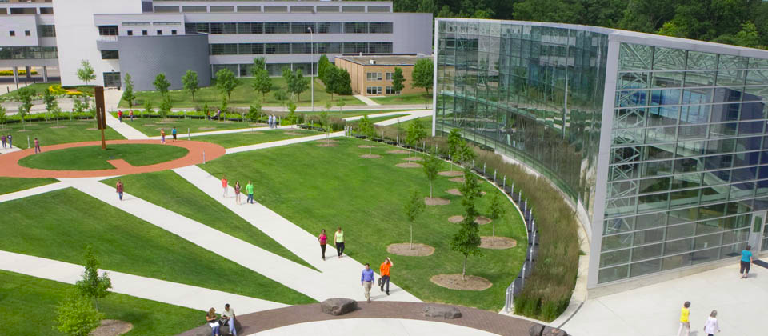
LTU is a small, non-profit, private university on an urban campus within metro Detroit

Slide 3
LTU Organization
Lawrence Technological University
CoAD
CoAS
CoBIT
College of Engineering
BME
CAE
ECE
ET
Mechanical, Robotics, and Industrial Engineering
BS Mechanical Engineering
BS Robotics Engineering
BS Industrial Engineering
MS Automotive Engineering
MS Mechanical Engineering
MS Mechatronics & Robotics Engineering
MS Industrial Engineering
M Engineering Management
PhD Mechanical Engineering

Slide 4

LTU differentiators
“Theory and Practice”
Strong historical ties of automotive industry
Significant number of adjunct faculty from industry
Availability of evening classes (4:20pm to 7:10pm start times)
Focus on problem-based learning
Laptop program
All undergrads and faculty issued a common laptop
Preloaded with all needed software (e.g., MATLAB)
Help Desk provides new drive image every Fall
Small class sizes
All classes taught by faculty (no TAs)

Slide 5
Our student population reflects both our status as a private university and our location in metro Detroit
 | Students | Student Jobs | Class Offerings
BSRE | ~95% domestic ~5% international | Many start jobs in junior year | Day & Evening
MSMRE | 80% domestic 20% international | 100% domestic ~50% international | Evening

Slide 6
Aside: MRE definitions
A survey was distributed to compare “mechatronics” and “robotics”
Definition of “mechatronics” and “robotics”
Likert-scale questions about preference between “mechatronics” and “robotics” relevant to stakeholder
Free response on additional differences
Stakeholders | N
Prospective engineering student | 2
Current engineering student | 76
Engineering educator | 30
Industry professional | 24
Overall | 132

Slide 7
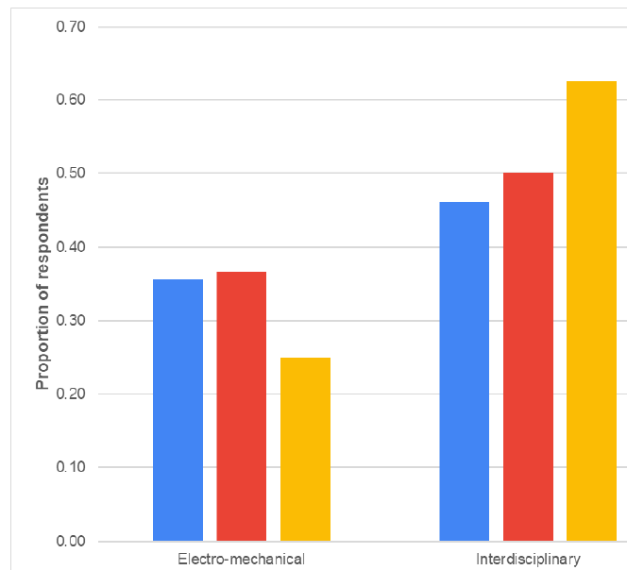
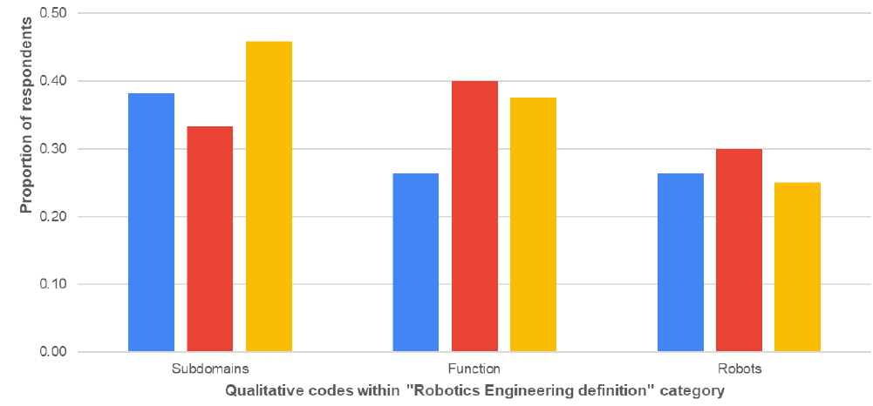
Mechatronics vs. Robotics definitions
Mechatronics
Electro-mechanical only
Electro-mechanical plus computer and control
Robotics
Mechanical, electronic, computer, control
Sense-think-act
Related to robots (“I know it when I see it”?)

Slide 8
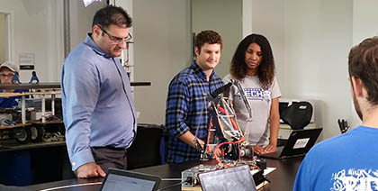
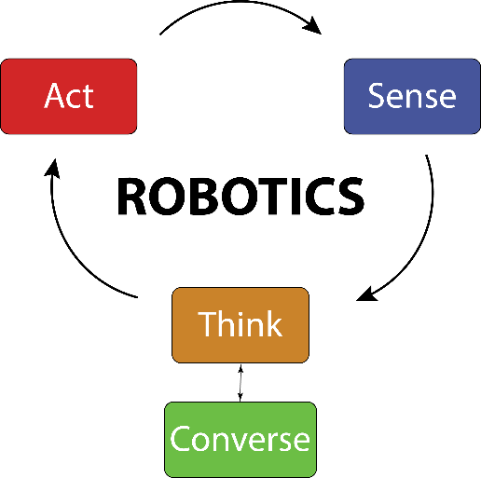
BS Robotics Engineering
Program launched in 2011
First ABET review in 2016
Combines fundamentals of mechanical engineering, electrical engineering, and computer science
Robotics-specific design sequence
Industry-sponsored and competition-series capstone projects

Slide 9
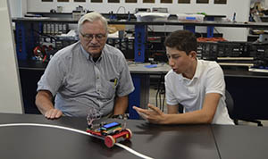
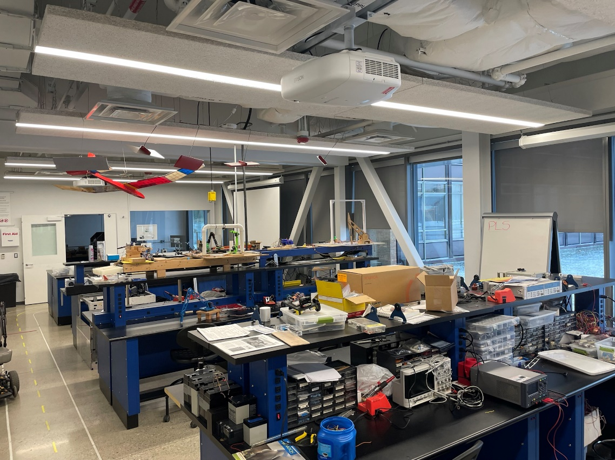
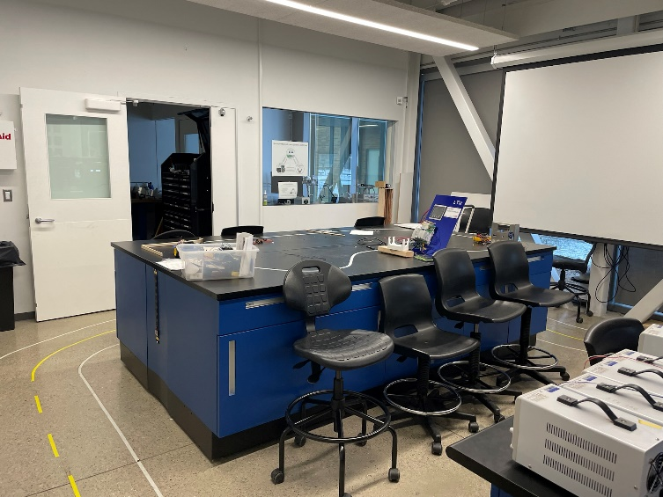
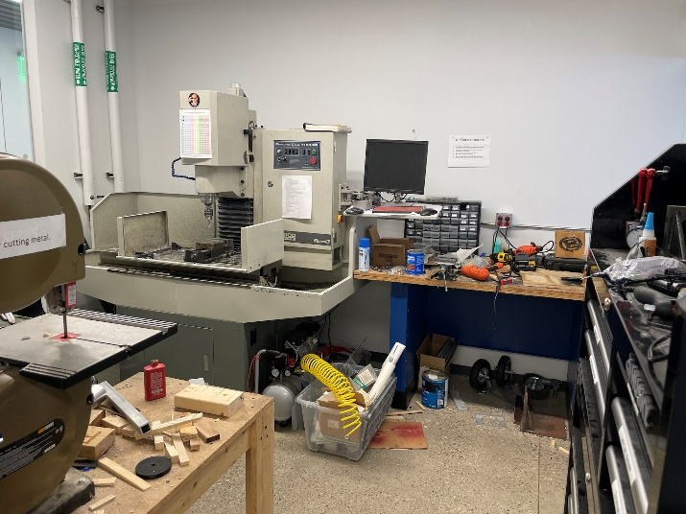
Robotics Lab
Project space for BS Robotics Engineering
Electronic equipment, basic components, work space, space to test autonomous platforms, light fabrication facilities, 3-D printing
Supervision from Laboratory Instructor

Slide 10
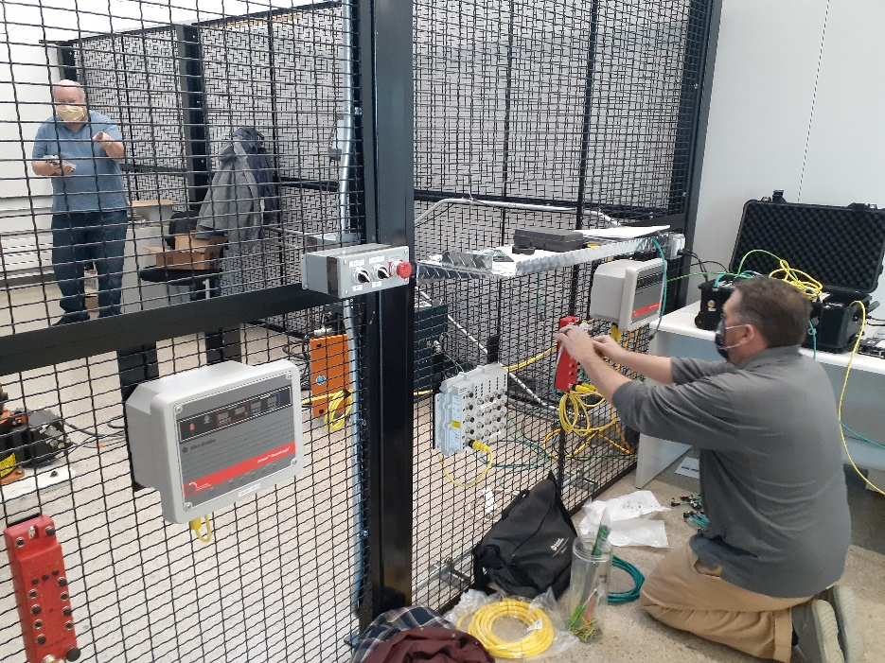
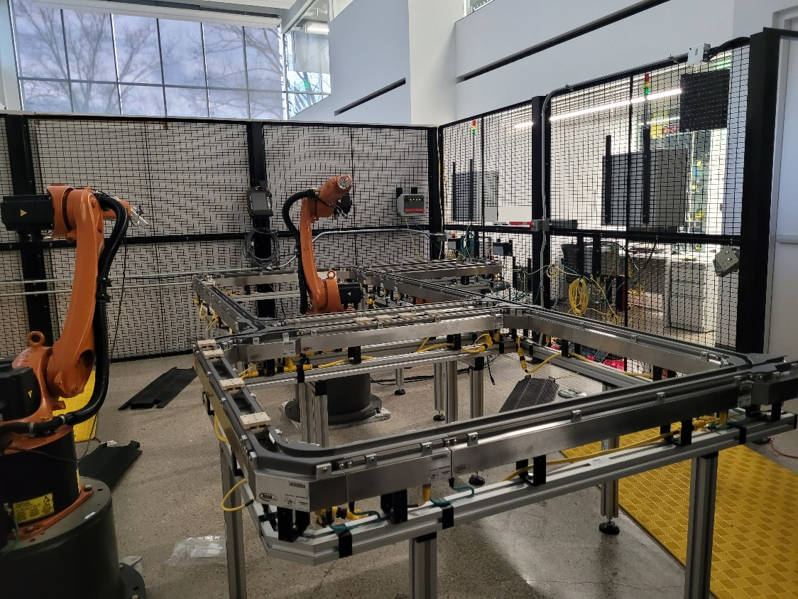
Robotics Engineering Automation Lab
Students program KUKA robot arms to simulate industrial processes
Current partnership with Rockwell Automation, KUKA, and others to upgrade the lab

Slide 11
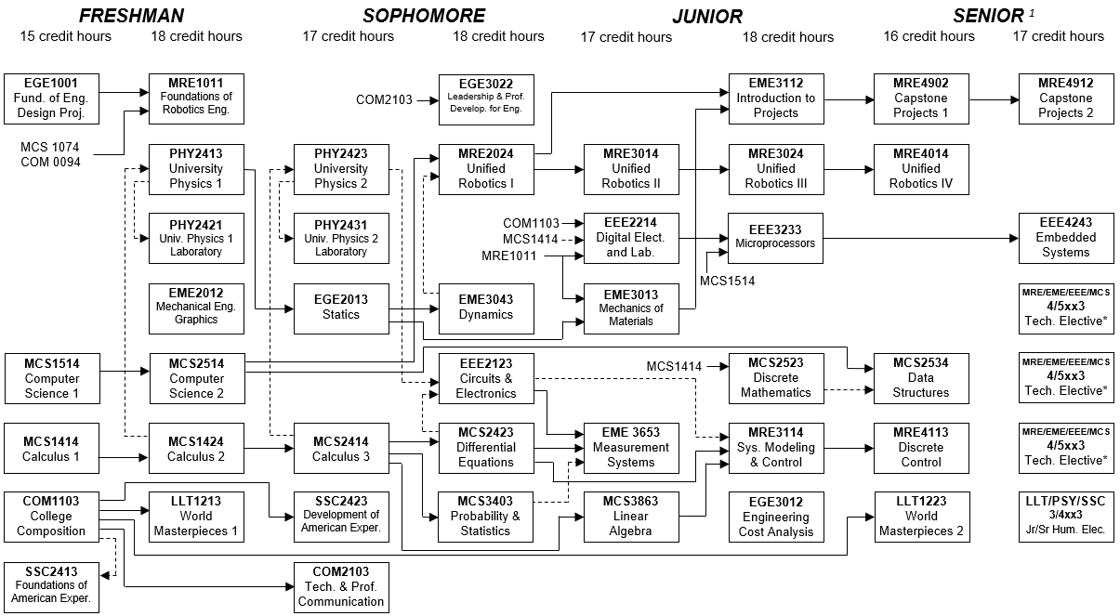
BS Robotics Engineering
8 semesters
136 credits

Slide 12
BSRE – Solid Mechanics

Slide 13
BSRE – Electronic Systems

Slide 14
BSRE – Computer Science

Slide 15
BSRE – Dynamic Systems and Control

Slide 16
BSRE – Robotic Design

Slide 17
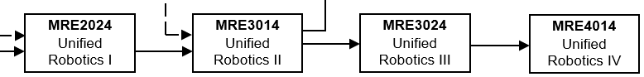
LTU Unified Robotics sequence
Microprocessor programming
Circuits, sensors, actuators
Rigid body kinematics, robot dynamics
Dynamics, Lagrange
Robot vision, software engineering
Forward / Inverse Kinematics of Robots
Robot maintenance (industry partner)
Power sources
PLCs
Mechanical design
Machine learning

Slide 18
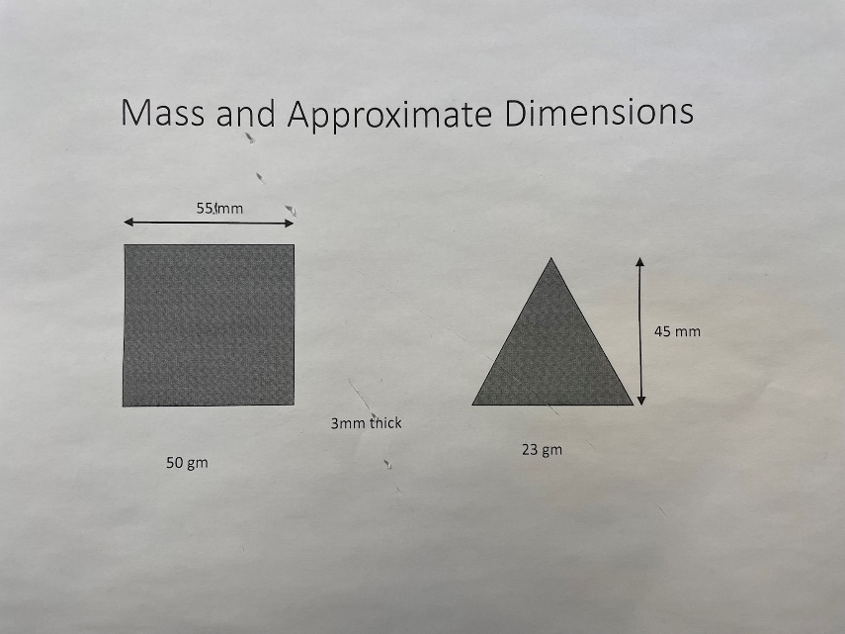
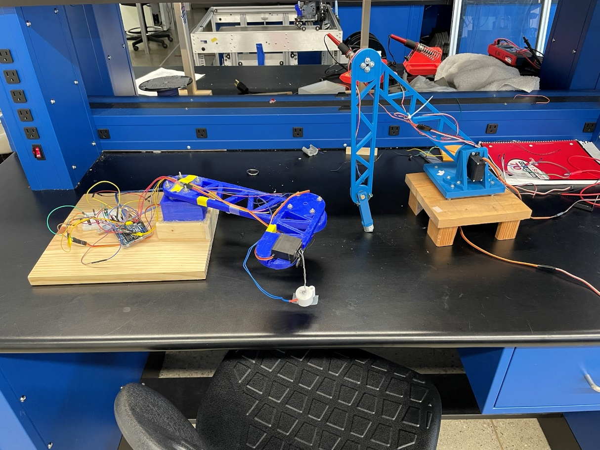
LTU Unified Robotics sequence

Slide 19
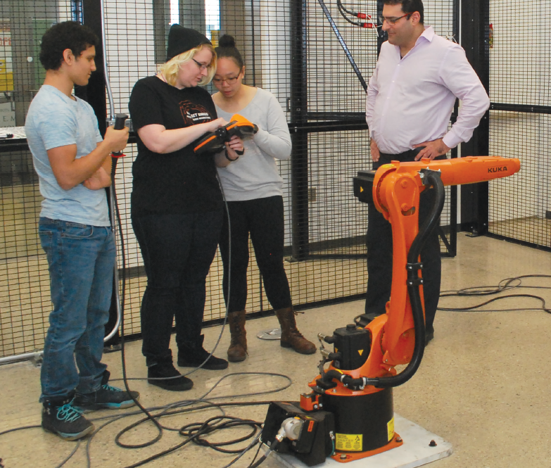
LTU Unified Robotics sequence

Slide 20
Electives include MRE, ME, EE and CS (examples shown)
MRE 5143 | Aerospace Systems Engineering
MRE 5203 | Microrobotics
MRE 5213 | Bio-Inspired Robotics
MRE 5323 | Modern Control Systems
MRE 5813 | Unmanned Aerial Vehicles
EME 5213 | Mechanical Vibrations
EME 5223 | Advanced Mechanics of Materials
EME 5243 | Finite Element Analysis II
EME 5433 | Vehicle Dynamics 1
EME 5453 | Vehicle Crashworthiness
EME 5573 | Automotive HVAC 1
EEE 5274 | Digital Image Processing
EEE 5444 | Digital Communications
EEE 5654 | Digital Signal Processing
MCS 5323 | Artificial Intelligence
MCS 5243 | Theory of Computation
MCS 5403 | Intelligent Robotics with ROS
MCS 5623 | Machine Learning and Pattern Recognition
MCS 5803 | Algorithmic Design & Analysis
MCS 5813 | Cryptography

Slide 21
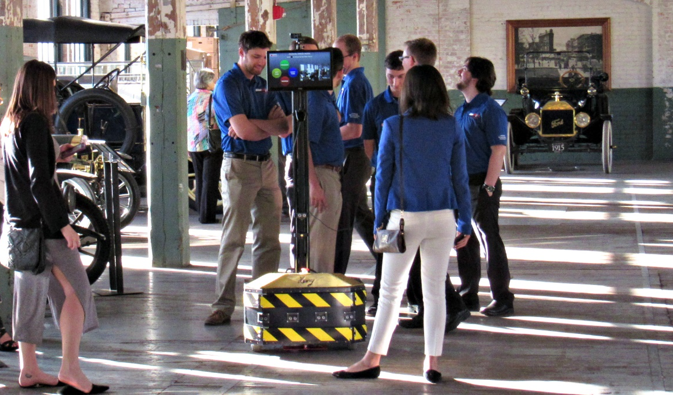
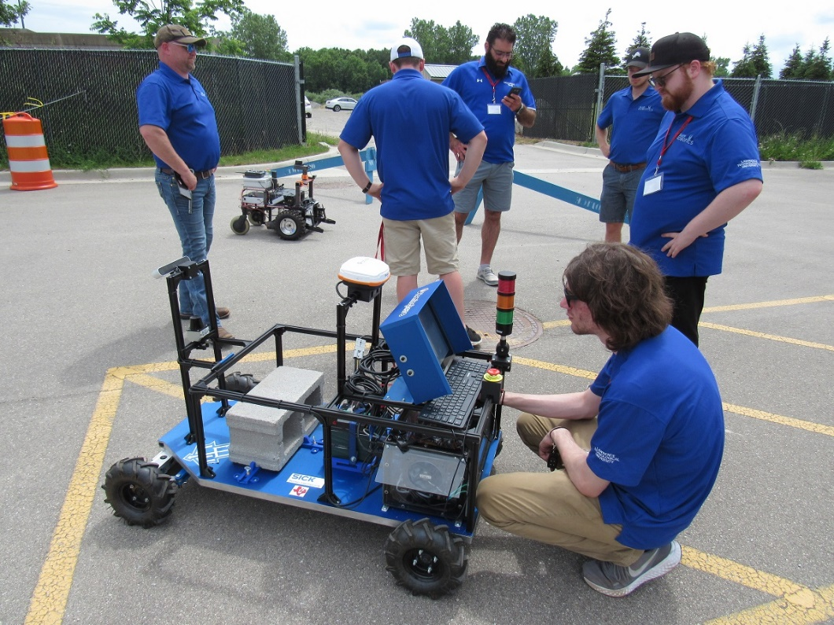
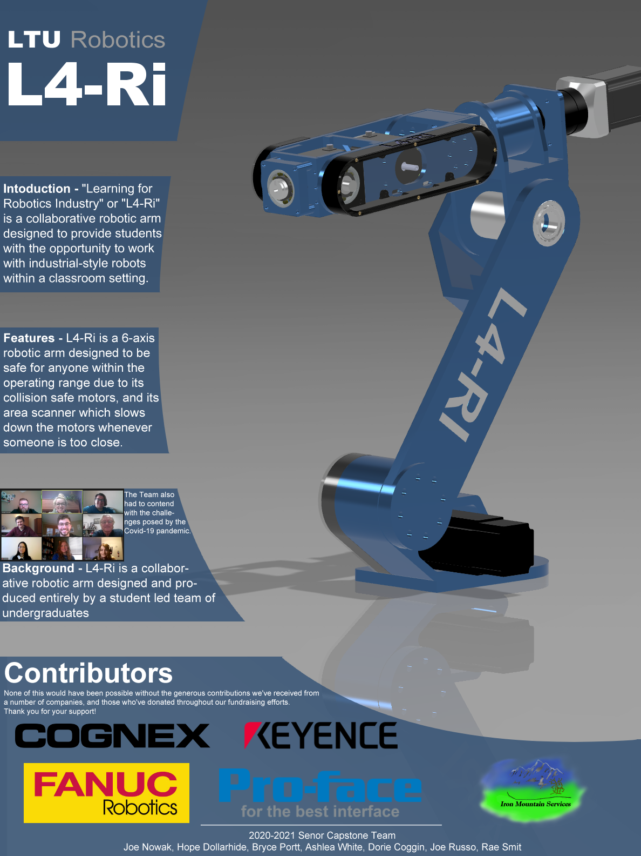
Capstone Projects

Slide 22
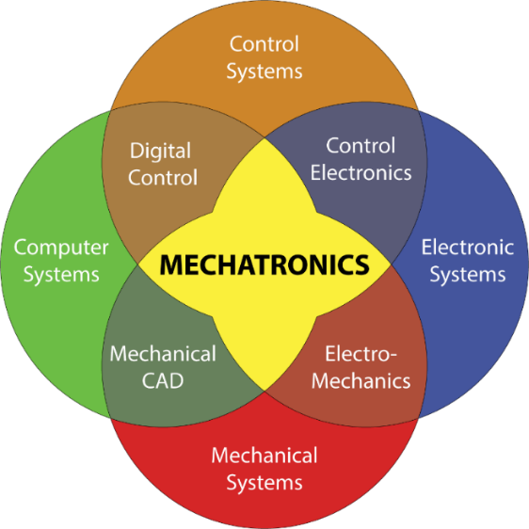
MS Mechatronics & Robotics Engineering
Program launched in 2006 (before BSRE)
Curriculum has evolved based on resources and demand
Most students come from traditional ME or EE undergrad
Subjects:
Advanced Dynamics
Modern Control Systems
Mobile Robot Design
Controller Implementation
Bioinspired Robotics
Microrobotics

Slide 23
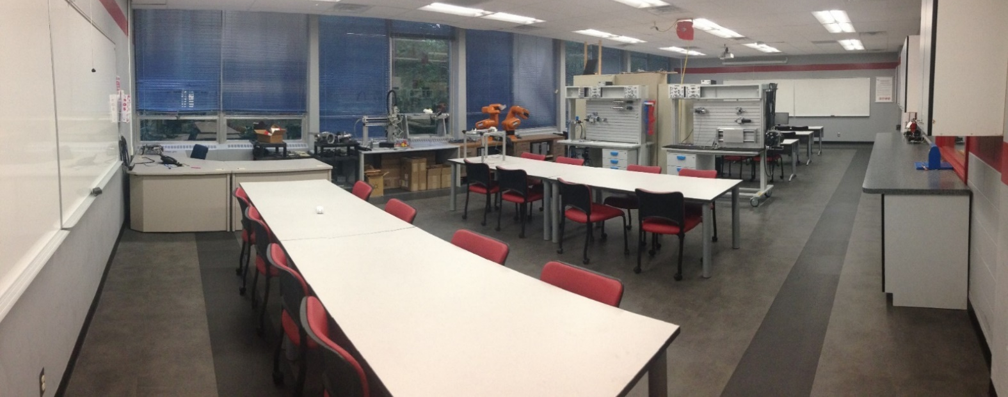
Mechatronic Systems Lab
Lecture space with desktop computers
Project space for laboratory work
Electronic test equipment, data acquisition and feedback control systems, hydraulic and pneumatic systems

Slide 24
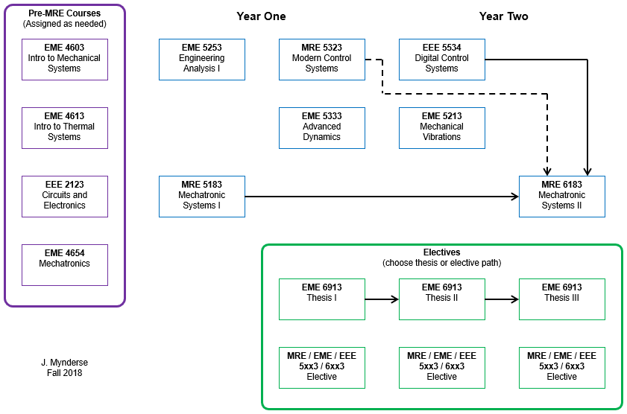
MS Mechatronic Systems Engineering
31 credits

Slide 25
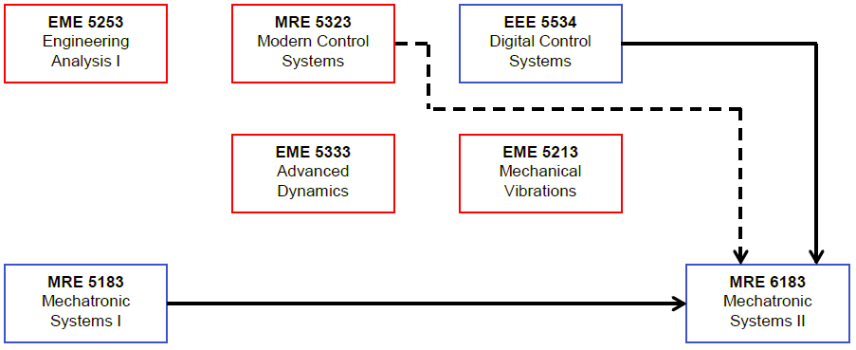
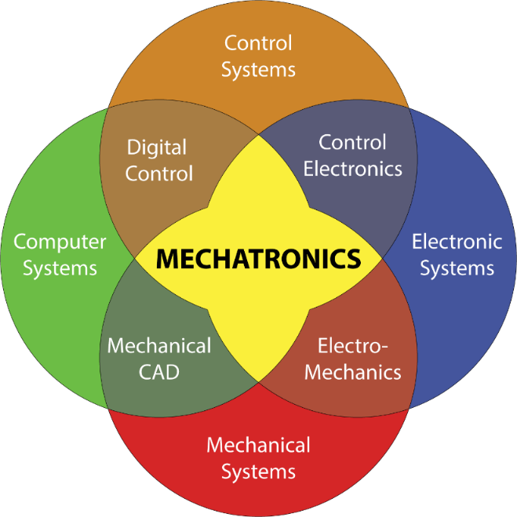
MSMRE curriculum is tied to our graphical definition of mechatronics
Mechanical Systems
Vibrations
Dynamics
Control Systems
Modern Control Systems
Digital Control Systems
Implementation (with Computer and Electronic Systems)
Mechatronic Systems 1 (lab)
Mechatronic Systems 2 (lab)
Electives (3) or Thesis

Slide 26
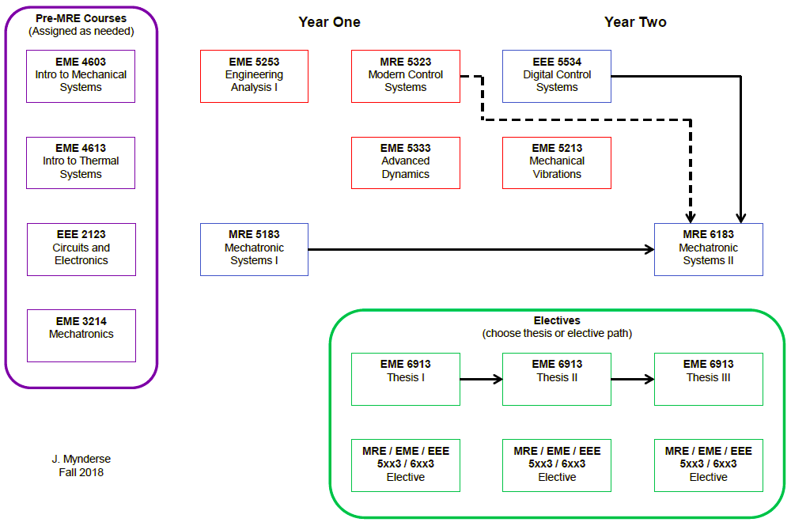
The program includes theory, “theory with practical applications” and practice
Theory + Practical Applications
Theory
Hands-On Practice

Slide 27
Required MSMRE-specific laboratory courses bookend the program
First course is exciting!
New students get an early taste of design
Undergraduate students get lured into the program
Last course is exciting!
Graduating students demonstrate what they have learned
Great talking points for both students and program

Slide 28
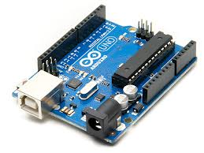
Mechatronic Systems 1 is an entry-level graduate course and a technical elective for undergraduates
Lecture topics:
Mechatronic design
Sensors and actuator integration
Finite state machines
7 structured labs using Arduino Uno platform
Group problem-based learning (PBL) design task

Slide 29
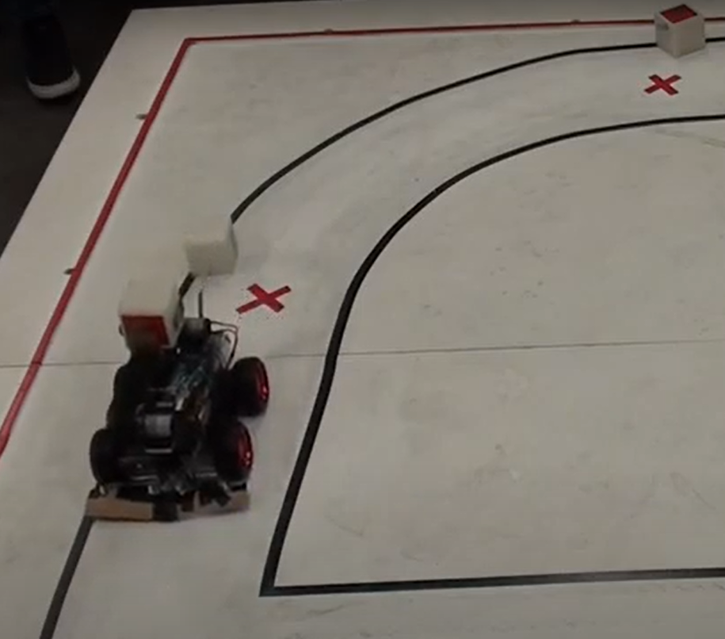
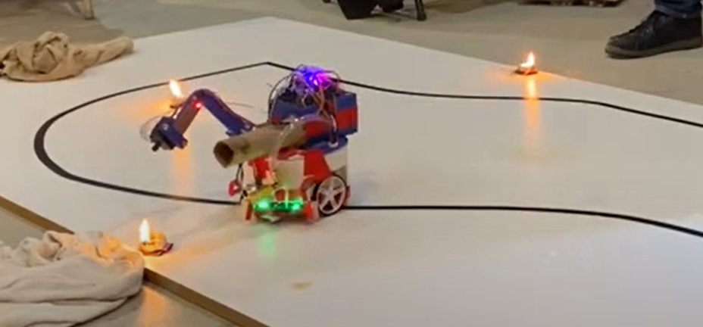
Student teams address a semi-realistic design challenge (different every year)
Delivering disaster relief
Fighting wildfires

Slide 30
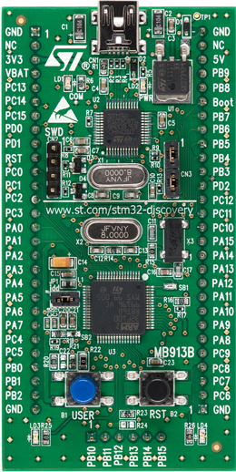
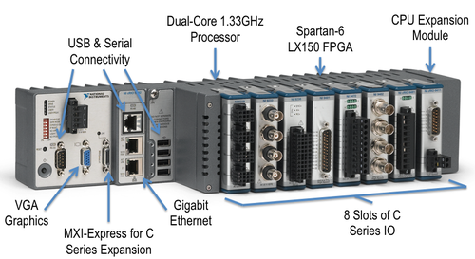
Mechatronic Systems 2 is an upper-level graduate course
Lecture topics:
Review of continuous controller design
Review of discrete controller design
Controller implementation using FPGA & microcontroller
Lab practice using NI cRIO, STM32 ARM processors
Group design task including controller design and implementation

Slide 31
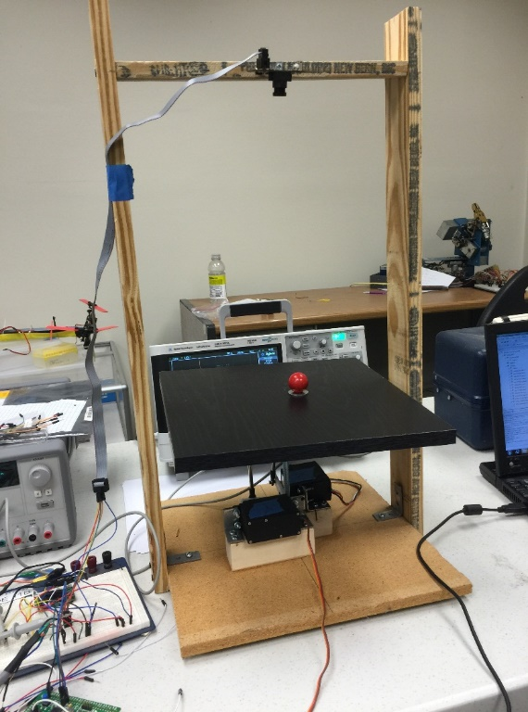
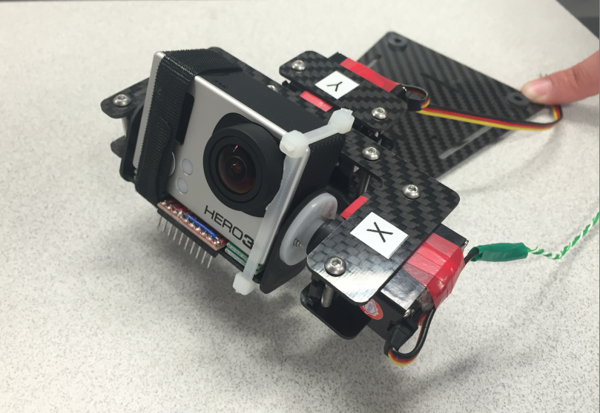
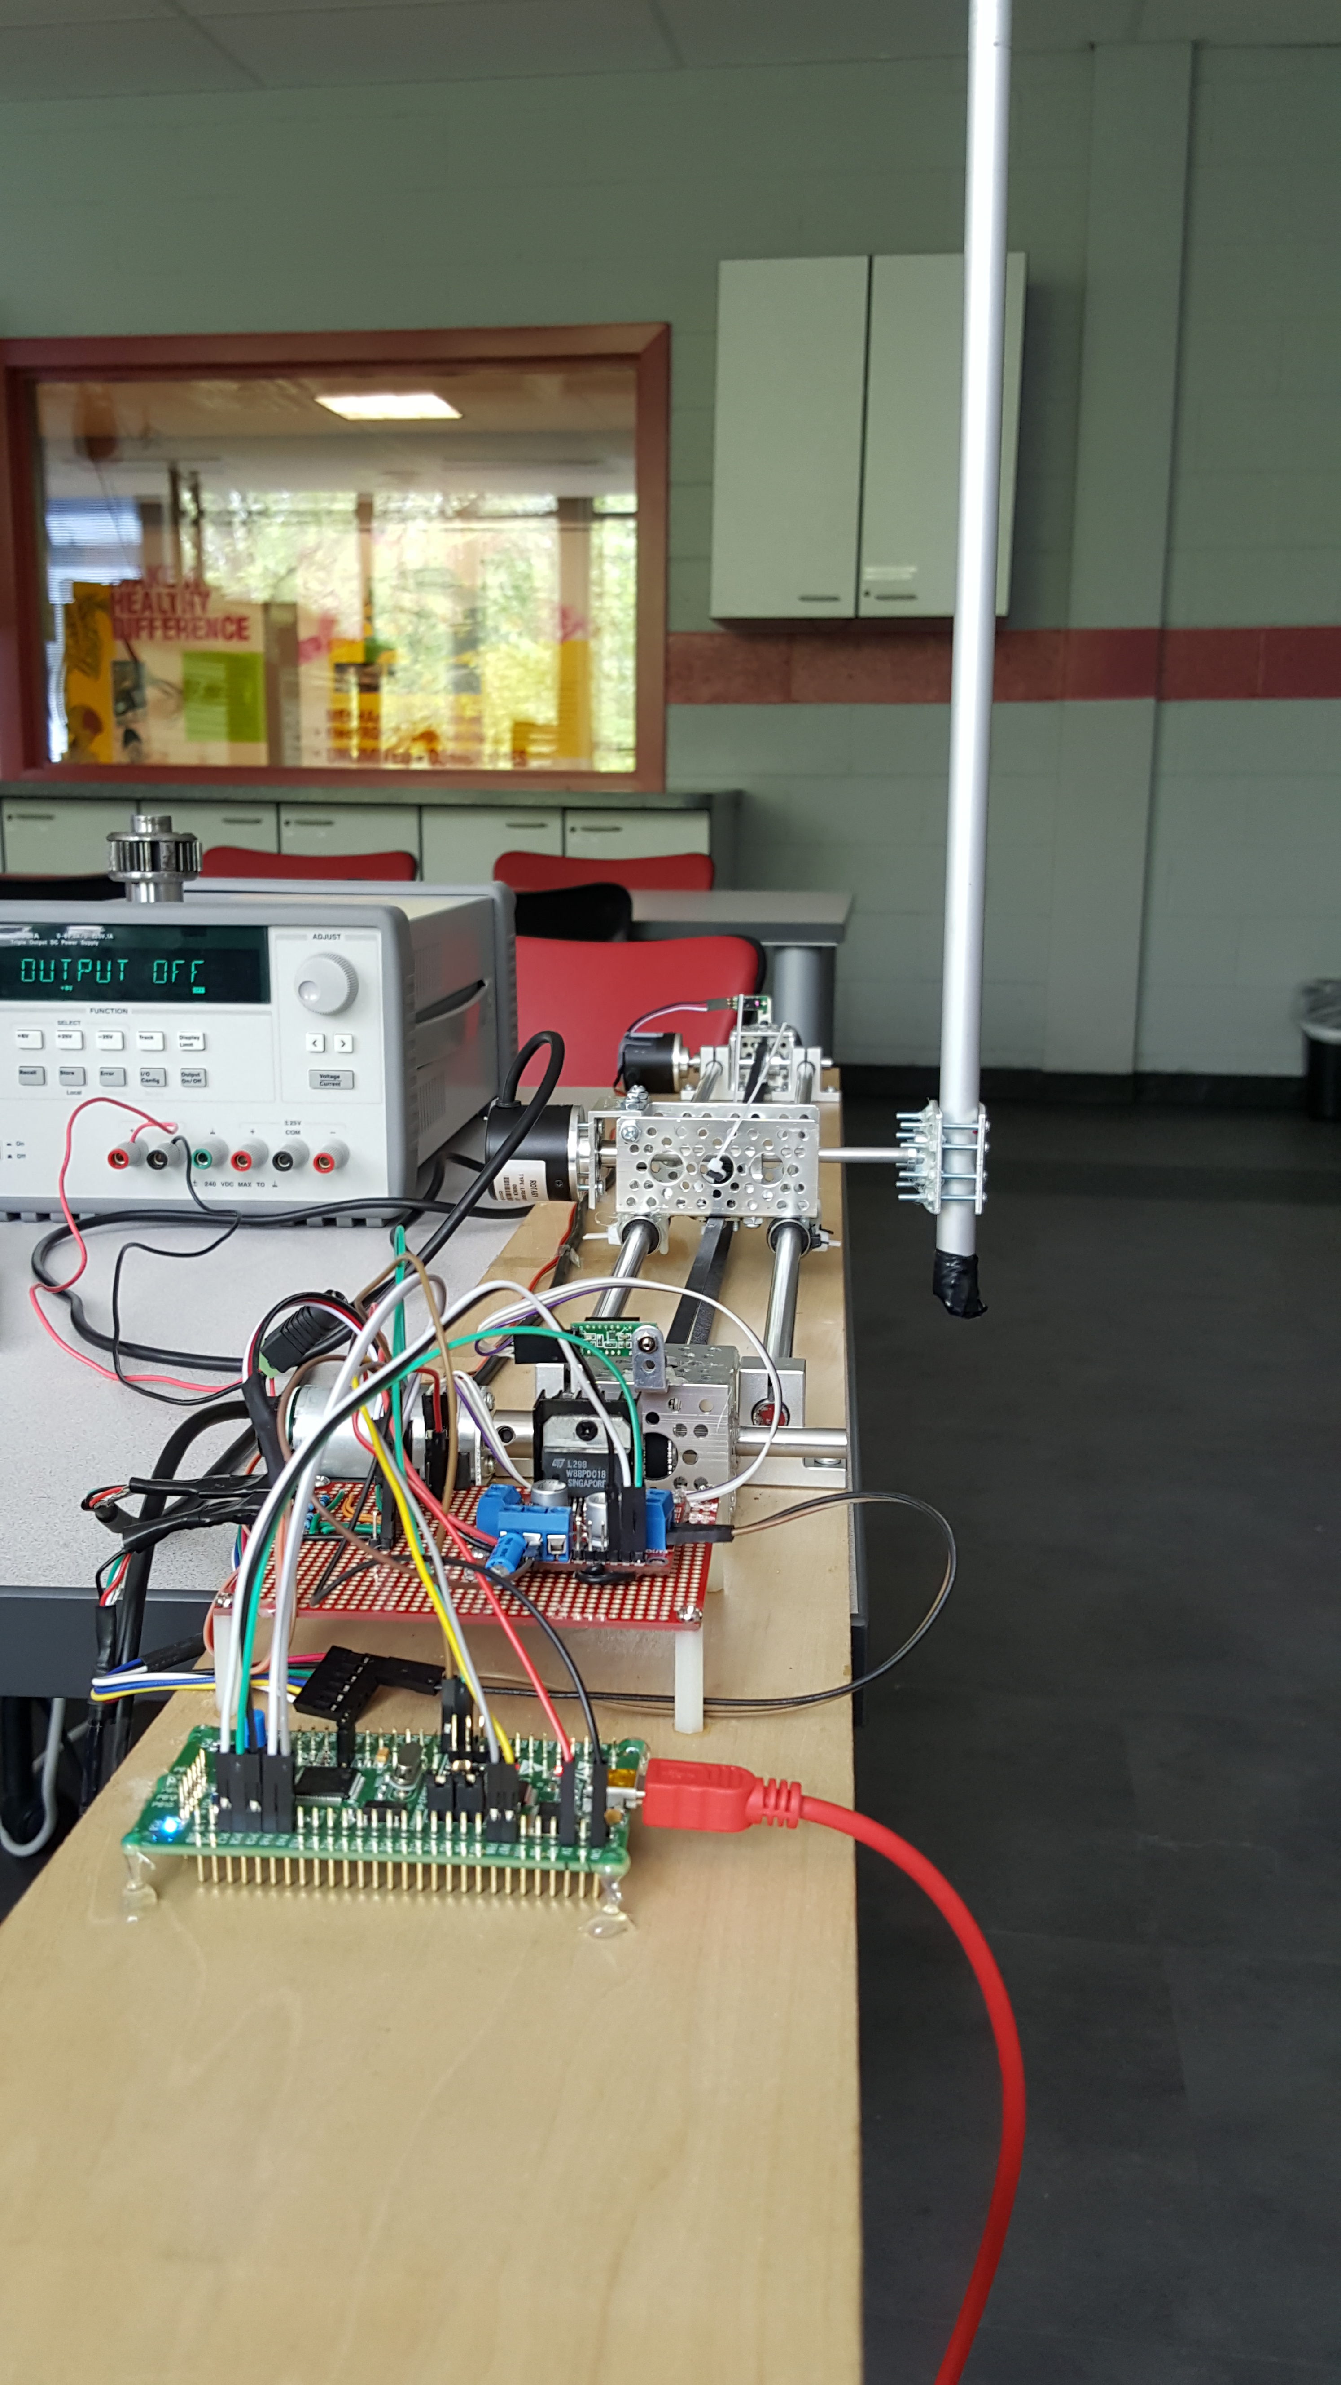
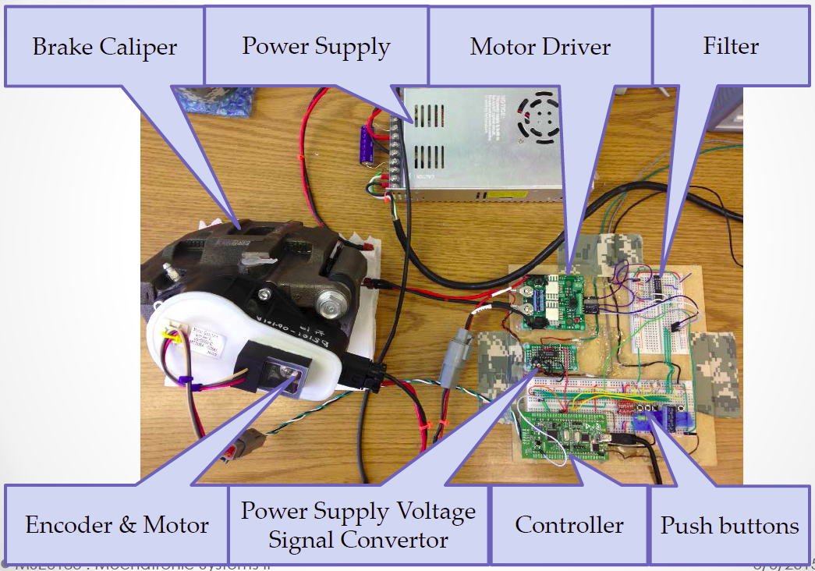
Student-selected projects vary in quality and results but all report substantial learning

Slide 32

Questions?

